Slide 1


Dental Clinic Services System
12/17/2014
Kanokwan Maneerat 542115002
Worapun Wongkium 542115055

Slide 2

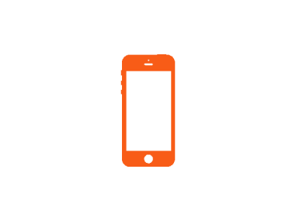


Agenda
Project Overview
Limitation
Software Methodology
Schedule
Features
System architecture & Design
Use Case Diagram & Description
Software Requirement Specification
Class Diagram
Sequence Diagram
Testing
Demo

Slide 3

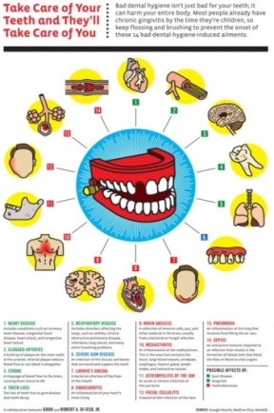
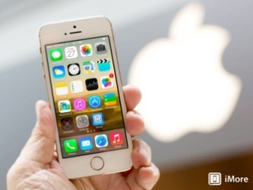



Project Overview
Dental clinic service system is created for reducing officers’ work and providing convenience to patients. This project will provide the dental clinic schedule for patients, officers, and dentists.

Slide 4
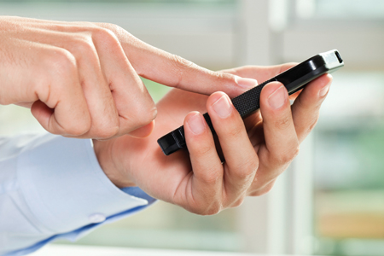

Project Overview
User
Visitor
View all appointment from Google calendar
Dental treatment cost estimation
Dental clinic information and promotion
Patient
View his/her appointment
View all appointment form Google calendar
QR code identification
Dental clinic follow up
Dental treatment cost estimation
Dental clinic information and promotion

Slide 5
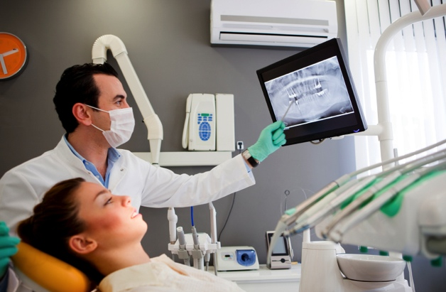

Project Overview
User
Dentist
View his/her appointment
View all appointment form Google calendar
Follow up by asking question to the patient
View the answer from patient

Slide 6
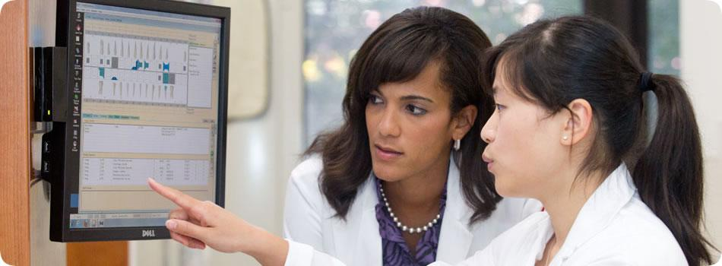

Project Overview
User
Officer
Create new appointment for patient and dentist
Create new account for patient and dentist
Save an appointment to Google calendar
View patient and dentist appointment
View all appointment from Google calendar
Add patient to a queue
Reset a queue
Manage dental clinic information and promotion
Manage dental clinic treatment

Slide 7
Project Overview
Dental clinic service system consists of a mobile application on iOS and a web application
Patient can login to view own appointment
Patient can view all appointment from Google calendar
Patient can login to view the personal information including QR code
Patient can view dental clinic information and promotion
Patient can estimate the cost of dental clinic treatment
Patient can follow up with dentist

Slide 8
Project Overview
Dental clinic service system consists of a mobile application on iOS and a web application
Patient and Dentist can login to view own appointment
Patient, Dentist, Visitor and Officer can view all appointment from Google calendar
Officer can make new appointment
Officer can create new account for patient and dentist
Patient can login to view the personal information including QR code
Patient and Dentist can do a follow up
Patient and Visitor can estimate the cost of dental treatment
Patient and Visitor can view dental clinic information and promotion
Officer can add patient to a queue
Officer can add/edit/delete dental clinic information ,promotion and dental treatment

Slide 9


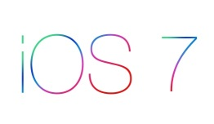
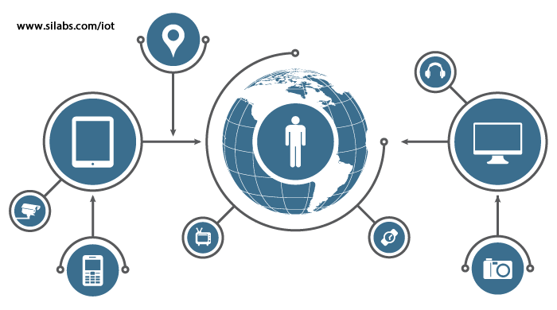
Limitation
Wifi and 3G
Should connect with the internet first
IOS7
Should use the ios7 or newer version

Slide 10
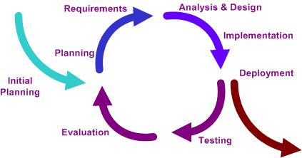
Software methodology
Iterative
develop a system through repeated cycles (iterative) and in smaller portions at a time (incremental)

Slide 11
Schedule
Progress 1 | Feature 1: Schedule management Feature 2: Appointment management Feature 3: User registration and authentication | 07/31/14
Progress 2 | Feature 4: Patient identification using QR code Feature 5: Dental care consulting and following up Feature 6: A dental clinic information and promotion Feature 7: Cost estimation of dental treatments | 10/22/14
Final Progress | Feature 4: Patient identification using QR code Overall documentation | 12/11/14

Slide 12
Features
Feature 1: Schedule management
Feature 2: Appointment management
Feature 3: User registration and authentication
Feature 4: Patient identification using QR code
Feature 5: Dental care consulting and following up
Feature 6: A dental clinic information and promotion
Feature 7: Cost estimation of dental treatments

Slide 13
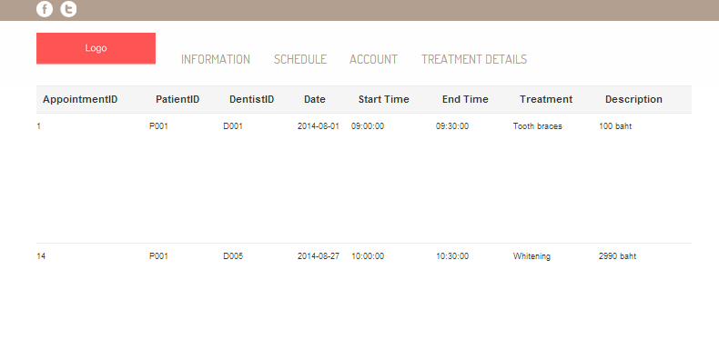
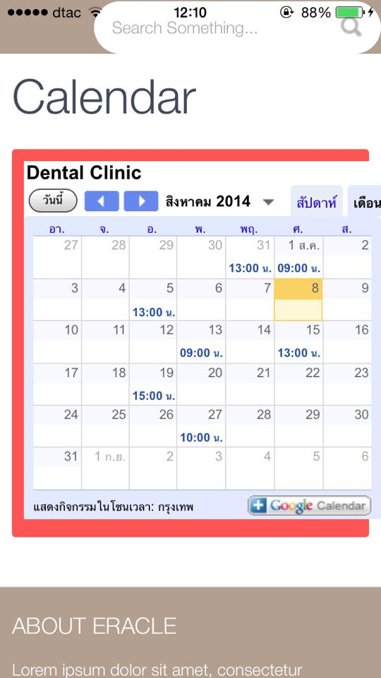
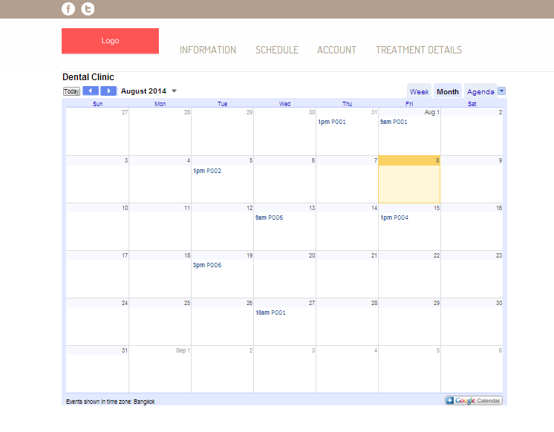
Features
Feature 1: Schedule management
Mobile application
Web application

Slide 14
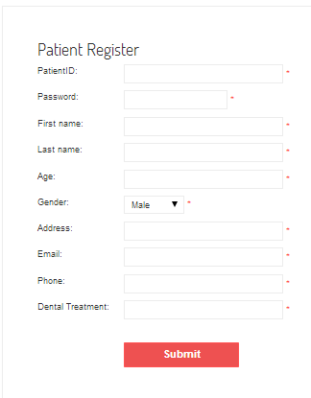
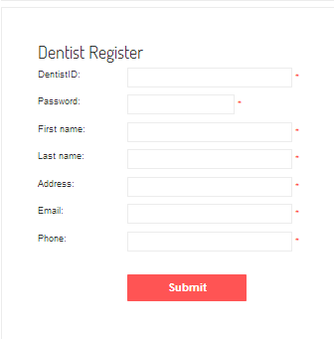
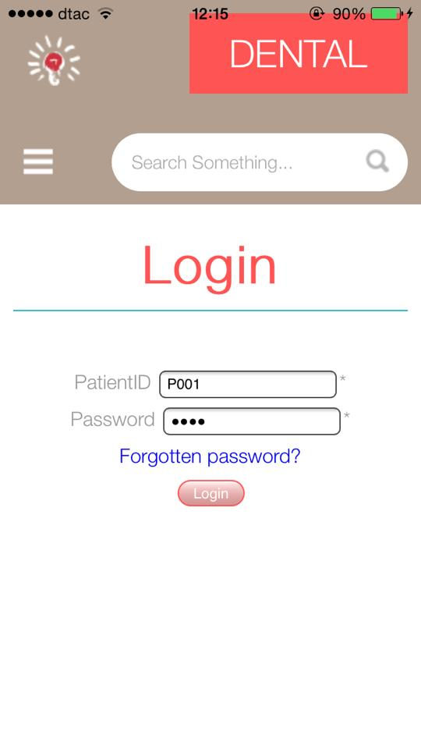
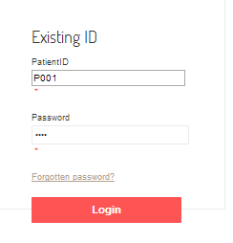
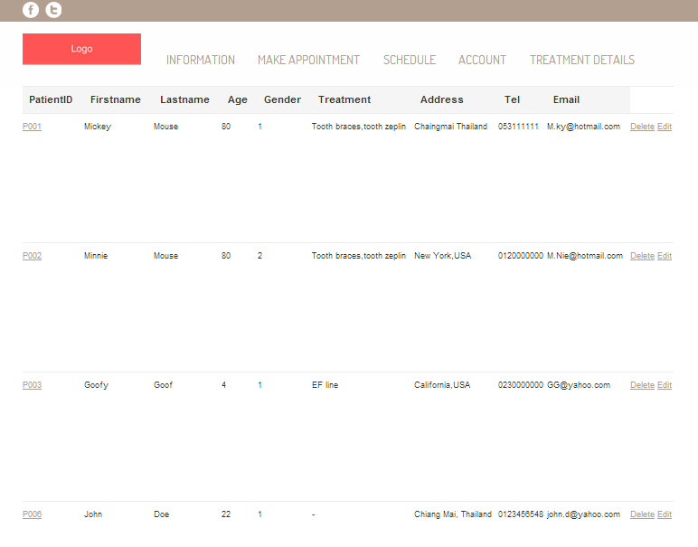
Features
Feature 2: User registration and authentication
Mobile application
Web application

Slide 15
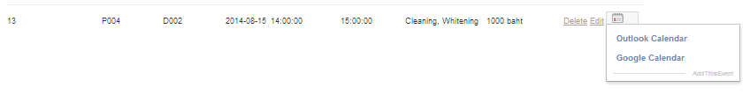
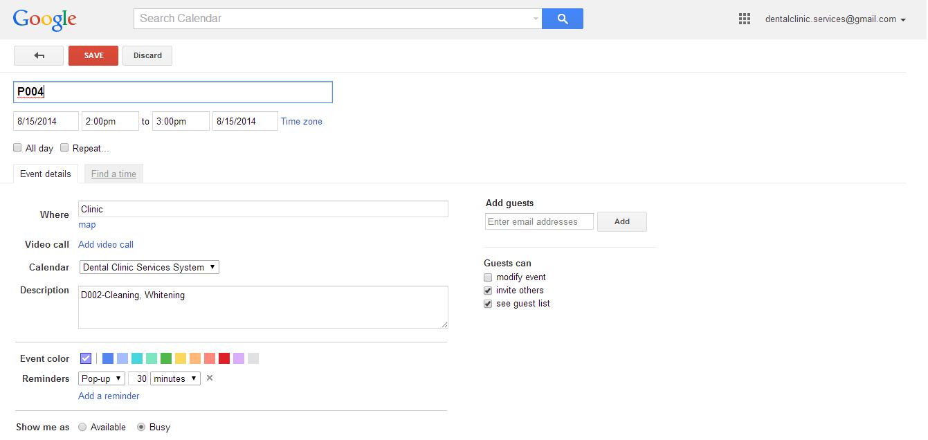
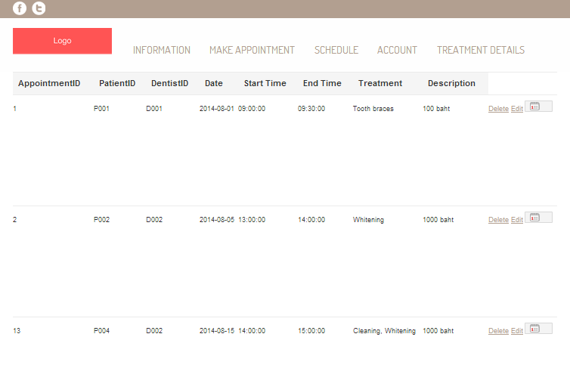
Features
Feature 3: Appointment management
Web application

Slide 16
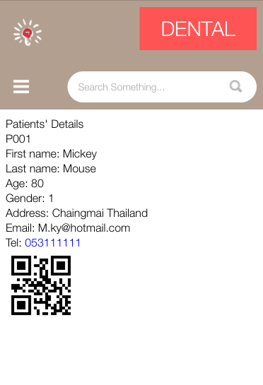
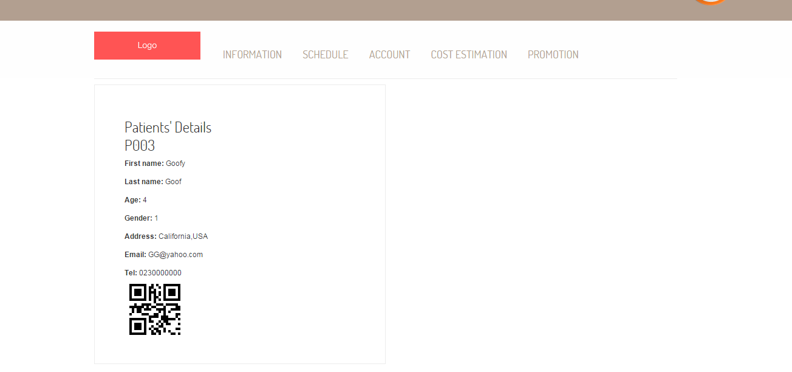
Features
Feature 4: Patient identification using QR code
Mobile application
Web application

Slide 17
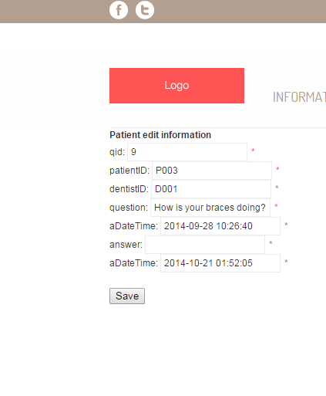
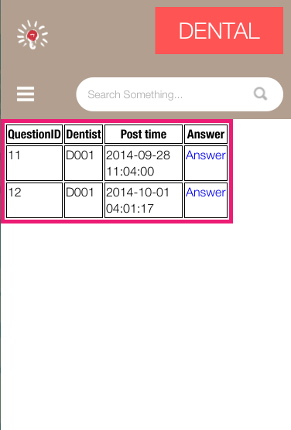
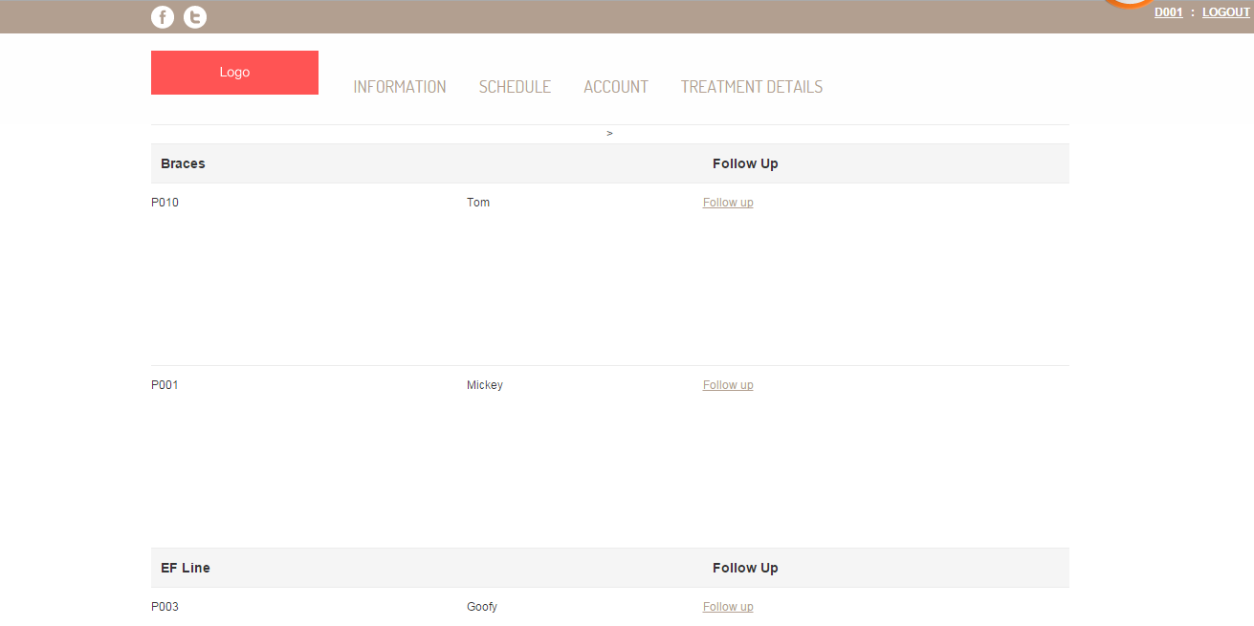
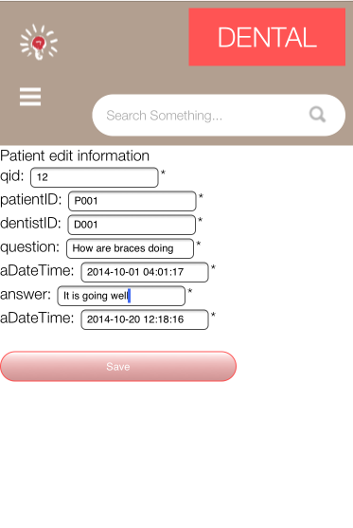
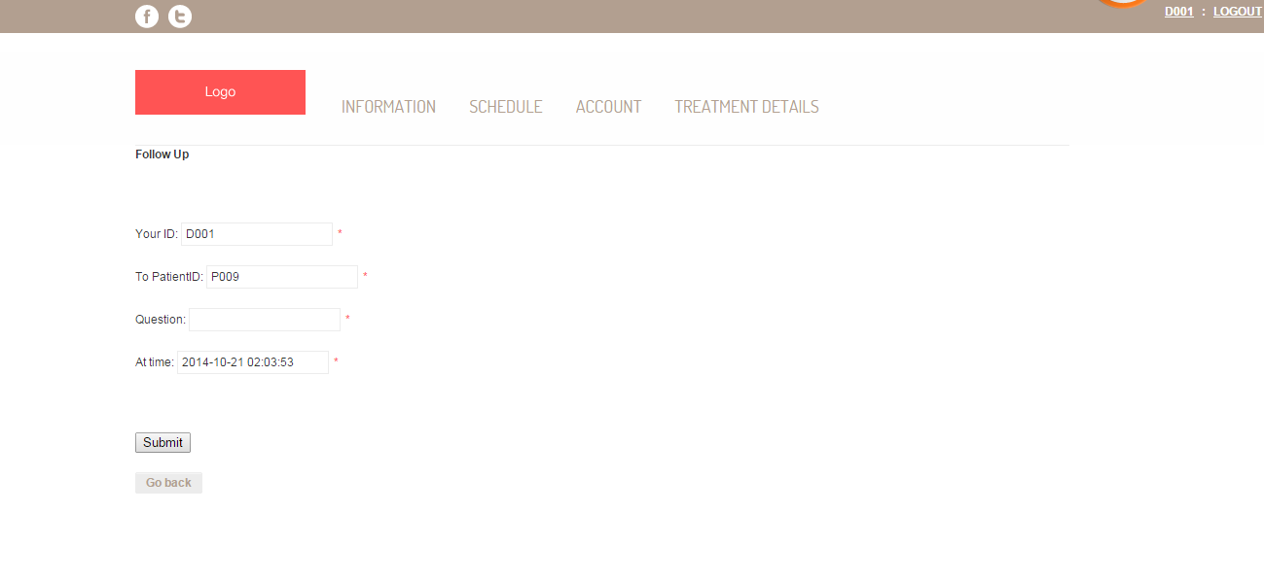
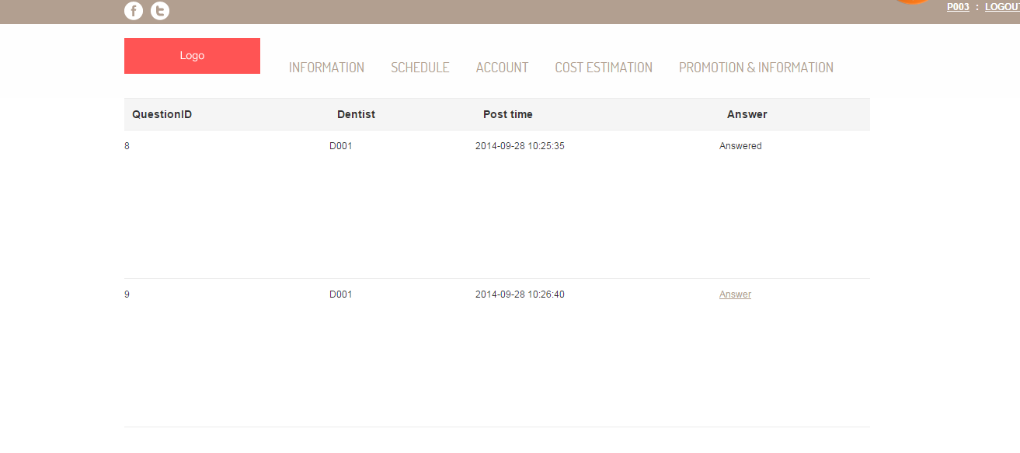
Features
Feature 5: Dental care consulting and following up
Mobile application
Web application

Slide 18
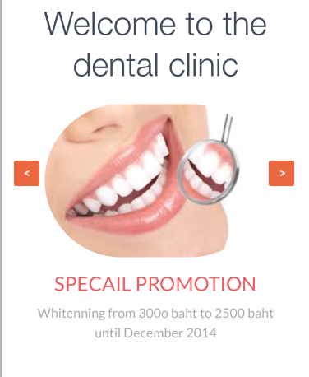
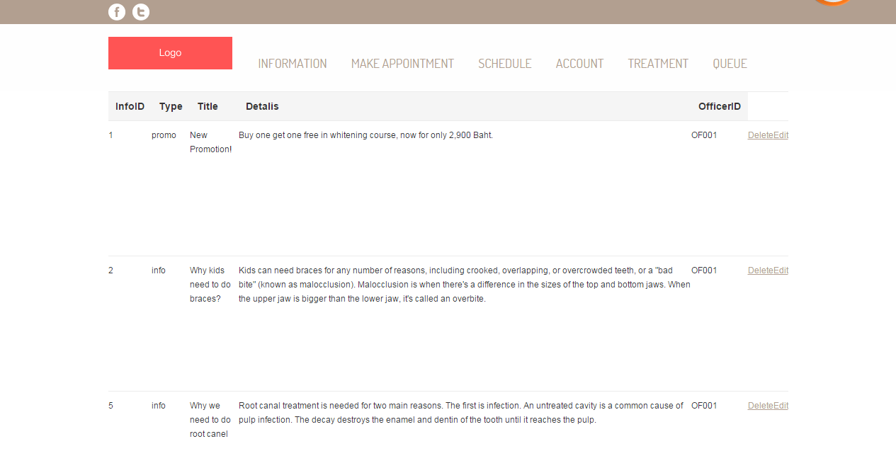
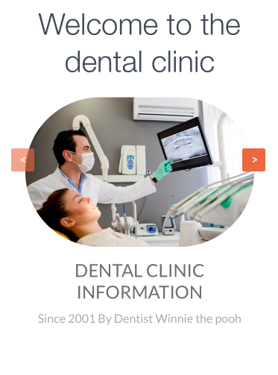
Features
Feature 6: A dental clinic information and promotion
Mobile application
Web application

Slide 19
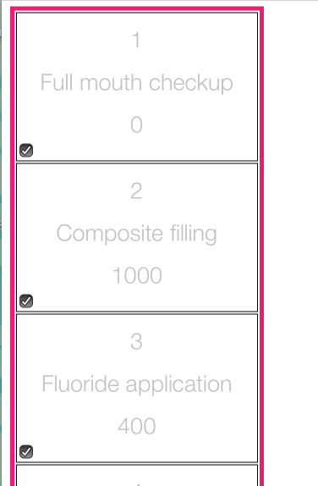
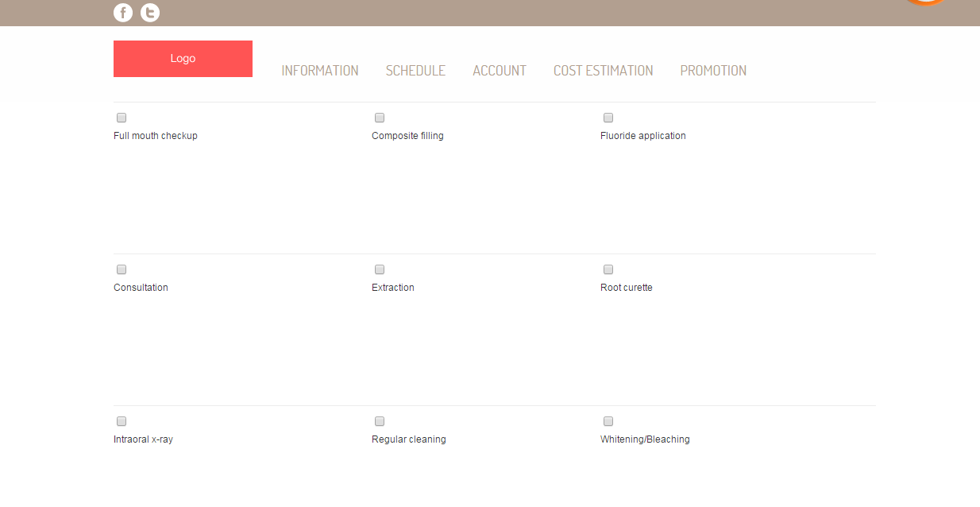
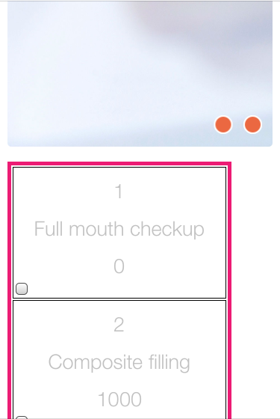
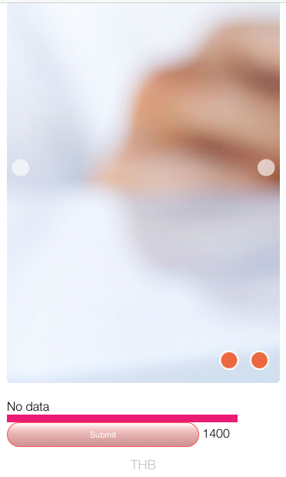
Features
Feature 7: Cost estimation of dental treatments
Mobile application
Web application

Slide 20
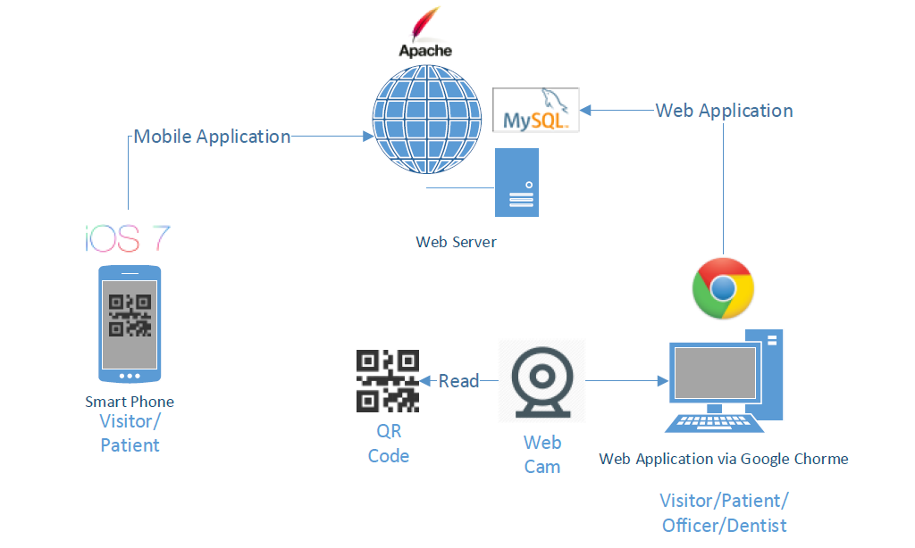
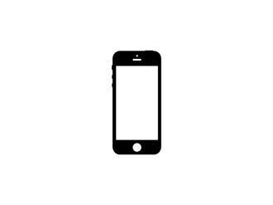


System Architecture
Web application

Slide 21
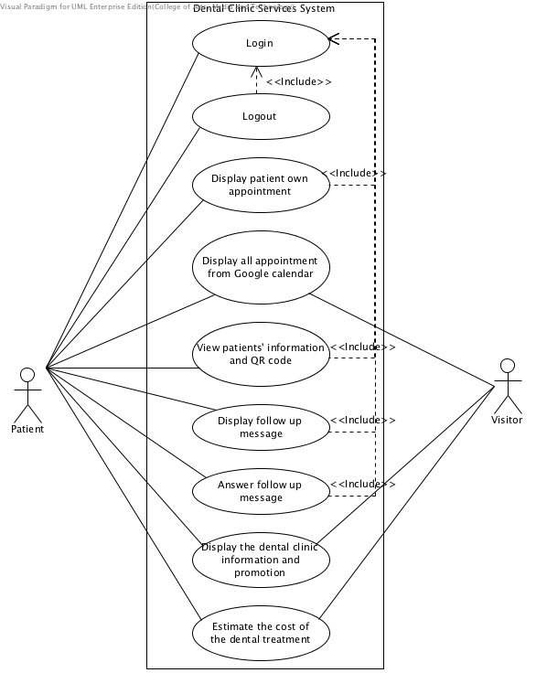
Use Case Diagram
Patient and Visitor

Slide 22
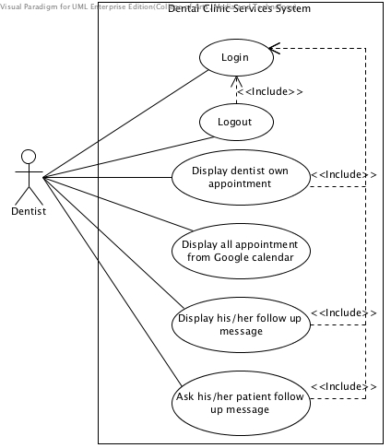
Use Case Diagram
Dentist

Slide 23
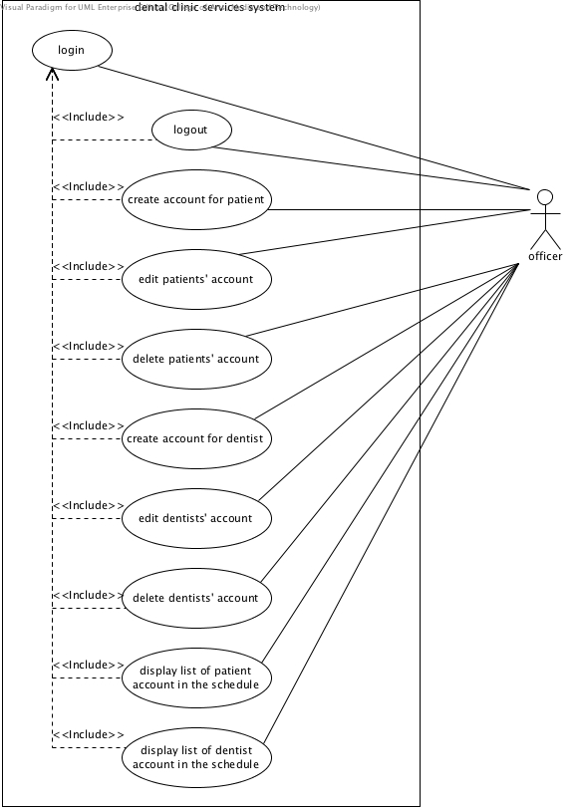
Use Case Diagram
Officer

Slide 24
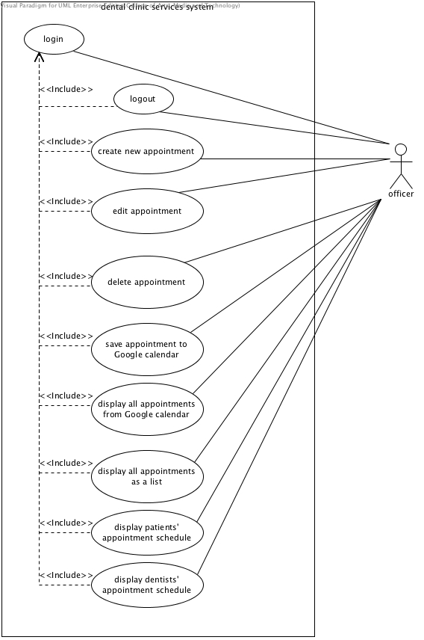
Use Case Diagram
Officer

Slide 25
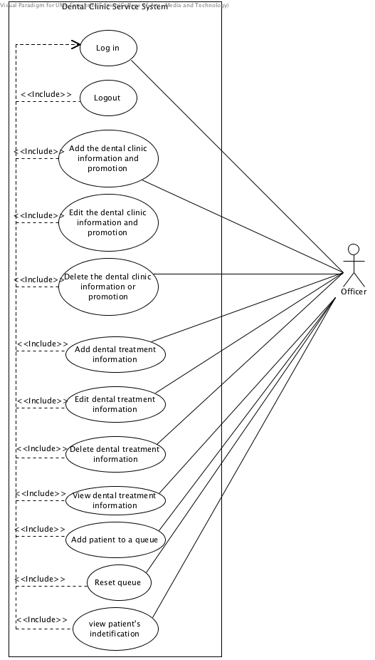
Use Case Diagram
Officer

Slide 26
Software Requirement Specification
URS-10: Officer can create new appointment
SRS-01: System shall connect with the database
SRS-10: System shall provide all appointments’ data as a list from the database in all appointment page
SRS-13: System shall provide create appointment page in the website
SRS-14: System shall add appointments’ data including patientID, dentistID, appointment date, start time, end time, dental treatment, and description into the database
SRS-15: System shall update appointment table in the database
SRS-59: System shall show error message “Please fill out this field” for any field that requires being not empty

Slide 27
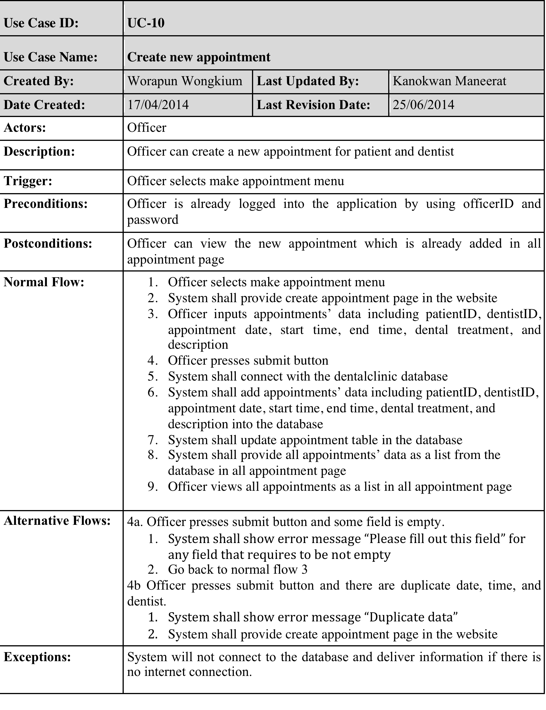
Use Case Description

Slide 28
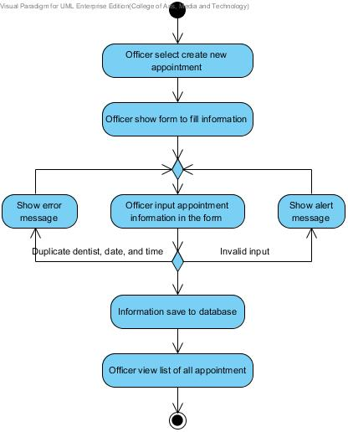
Activity Diagram
AD-10 :
Create new appointment

Slide 29
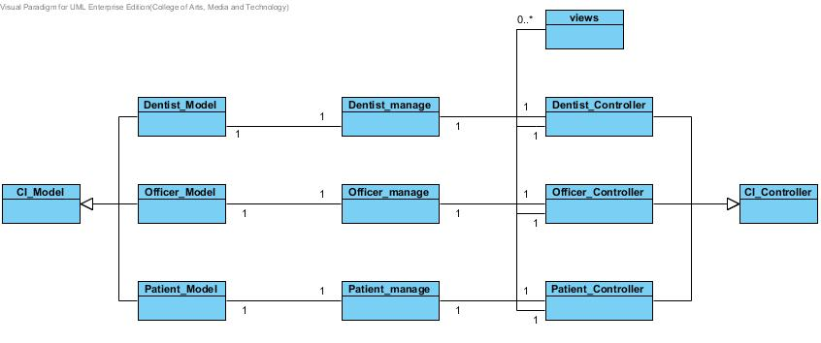
Class Diagram

Slide 30
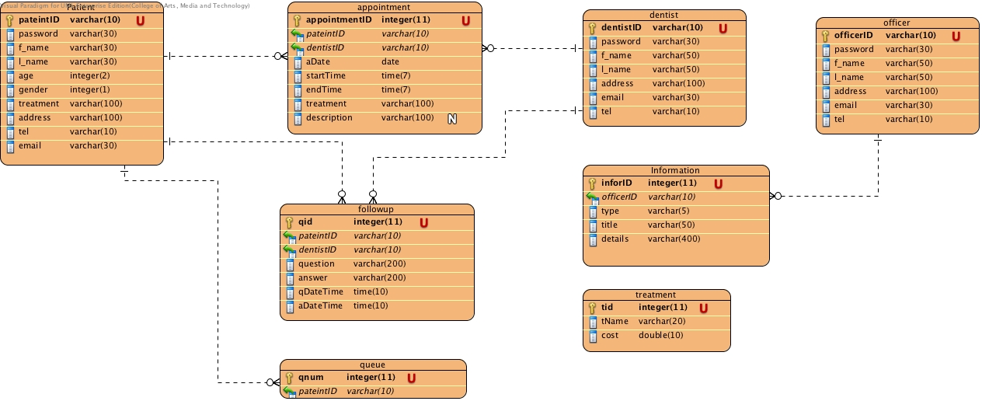
Database Diagram
Dentalclinic database

Slide 31
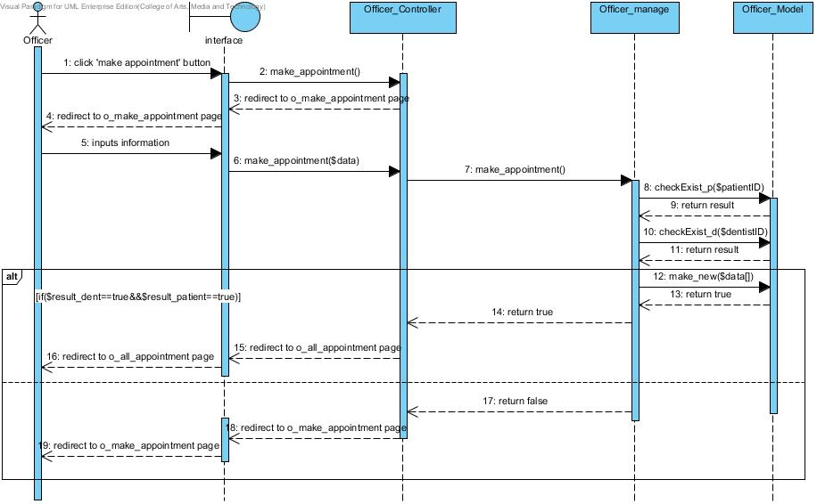
Sequence Diagram
SD-10 : Make an appointment
Officer

Slide 32
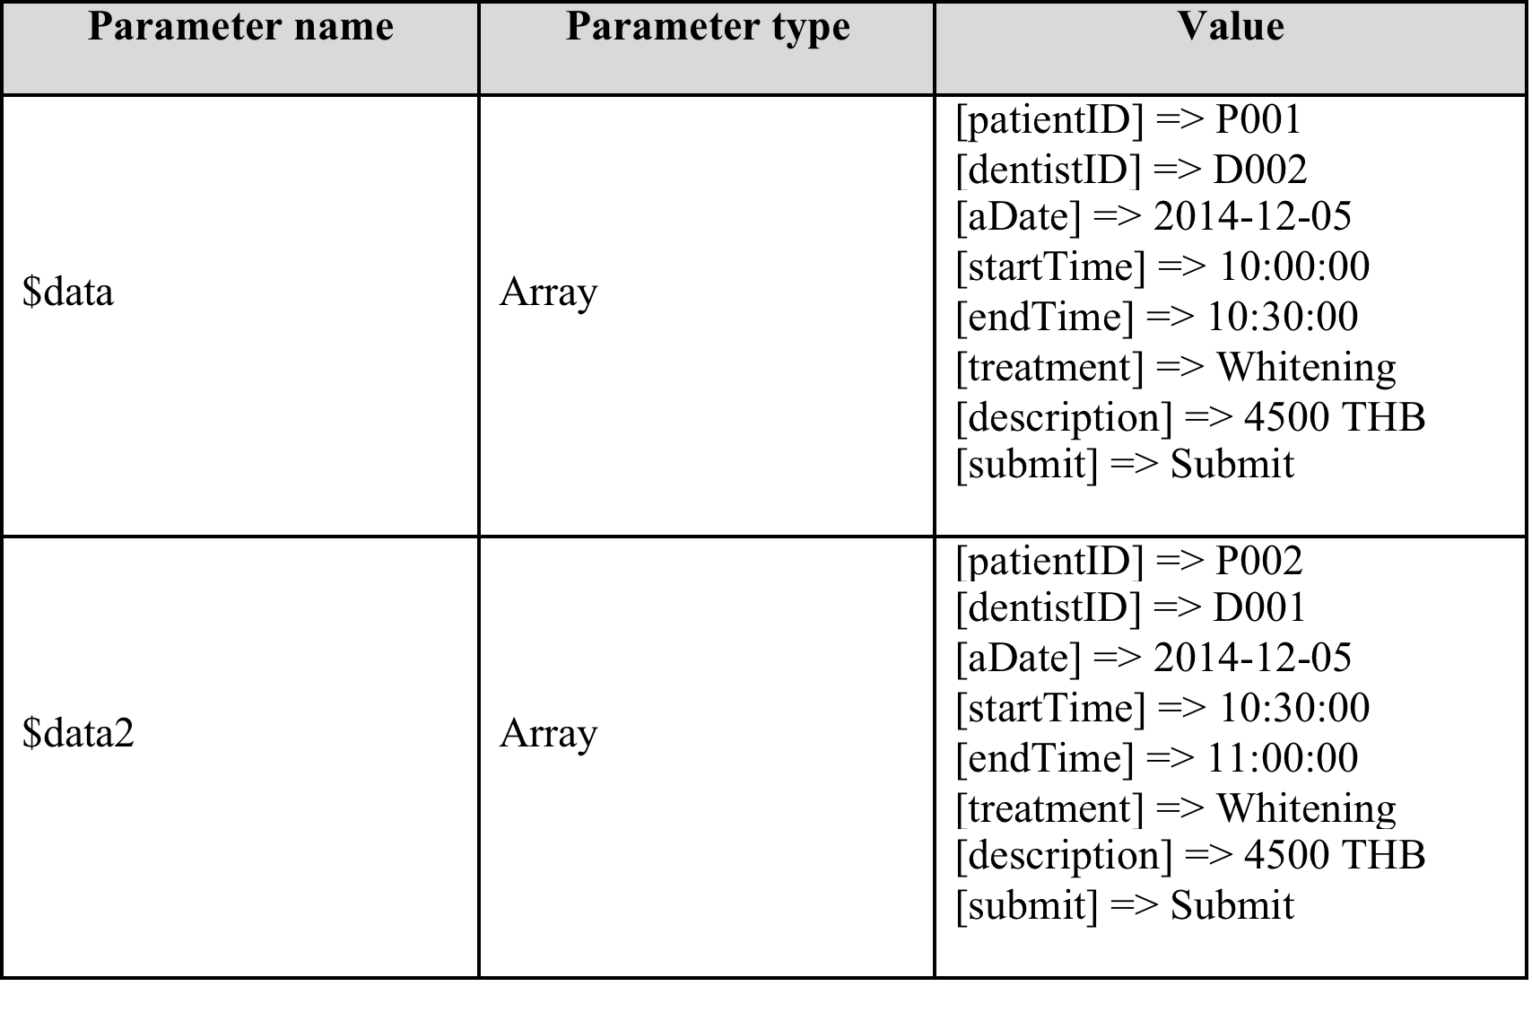
Testing
Unit test
Unit Test Case 15 (UTC-15): testmake_appointment()
Description: Test make appointment function by officer and input all required data : public function make_appointment($data)
Test Data:

Slide 33
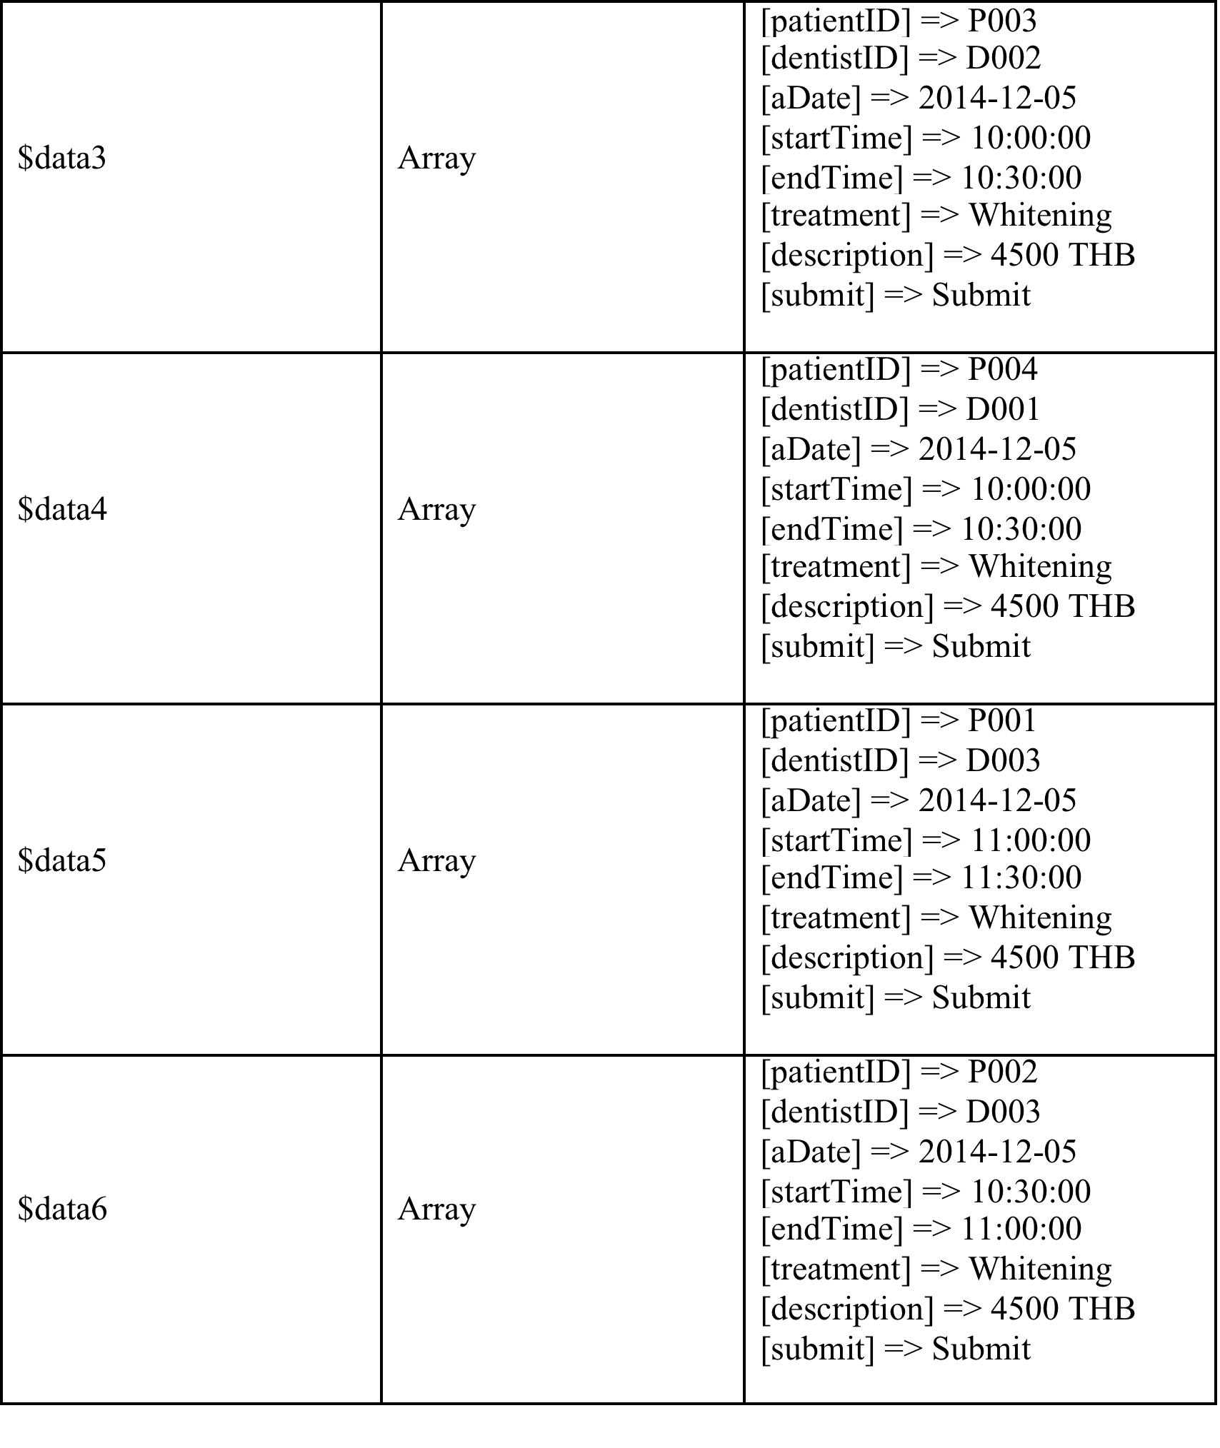
Testing
Unit test
Test Data:

Slide 34
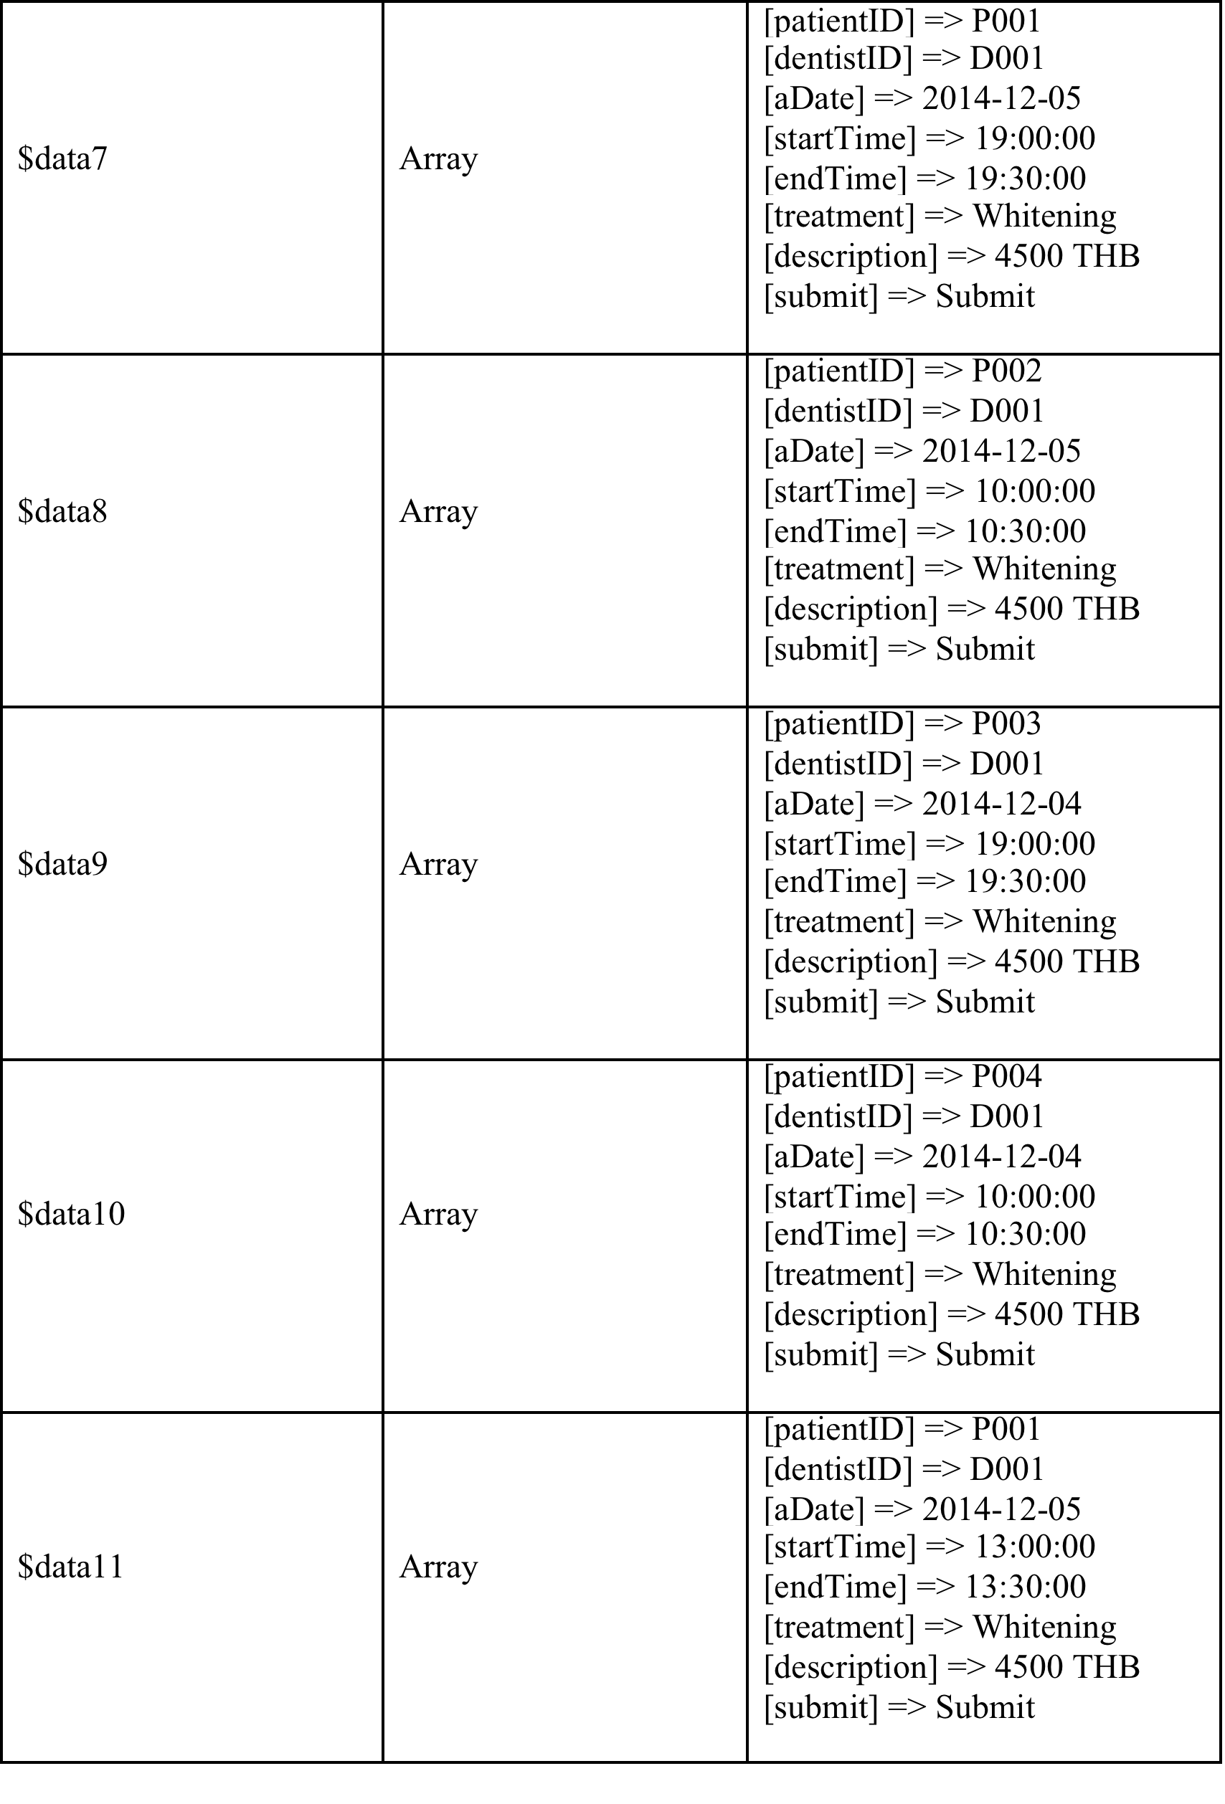
Testing
Unit test
Test Data:

Slide 35

Testing
Unit test
Test Data:

Slide 36

Testing
Unit Test Record
Unit Test Case 15 (UTC-15): testmake_appointment()

Slide 37


Testing
Unit test

Slide 38

Testing
Unit test

Slide 39



Demo

Slide 40
Q & A

Slide 41
Thank you
For your attention

